Slide 1
Network Properties
Prepared by: Hanan Begali

Slide 2
Overview :
Definition of Chemical space networks (CSNs) .
Aim of CSNs design.
Network properties.
Summary.
References.

Slide 3
Chemical space networks (CSNs) :
- Nodes represent compounds.
- Edges represent molecular similarity relationships.

Slide 4
Chemical space networks (CSNs) :
Goal:
- Visualization tool for the analysis of structure–activity relationships (SARs).
- Analyze relationships between compounds (similarity or dissimilarly biological activities).

Slide 5
Network properties:
Node Degree.
Clustering Coefficient.
Path Length.
Community Structure.
Network Density.
Assortativity vs disassortativity.
Notes:
Describe the features of chemical space networks.
- Emphasizes their statistical characteristics.
- Indicates various types of network topologies.

Slide 6
1) Node Degree :
Definition:
It is the number of edges attached
to a given node.
Connected nodes indicate similar biological activity between the compounds.
- Degree Distribution : probability that a selected node has exactly E links. P( E )
- Average node degree = 2*E/N
Degree:5
Notes:
Node Degree: how many edges connect to the node?
Distribution degree or average degree given by 2 *edges which here is 5/ all nodes(connection or unconnection nodes).

Slide 7
2) Clustering Coefficient(CC):
Measure for node`s neighbors connections.
Mathematical representation:
-V -> Node
-Kv -> Node degree
-Nv -> Number of links between neighbors of V(edges colored red)
CC(V) =2Nv/Kv(Kv-1)
For example:
CC(A)= (2 * 10)/7 *(7-1)
=10/21 =0.47
A
Notes:
Clutering co-efficient for a graph is the average of the clustering co-efficient of each node. It explains how likely is that two nodes connected form a part of a larger group of highly connected nodes. A clustering co-efficient for a node explains the fraction of possible interconnections between the neighbors of the node.

Slide 8
3) Path Length :
Measure the shortest path between two nodes in a chemical space network(CSN).
A
B
Notes:
A shortest path, or geodesic path, between two nodes is a path with the minimum number of edges.

Slide 9
4) Community Structure :
Network divides naturally into groups of nodes with
Dense internal connections .
Sparser connections between groups.
Principle:
Pairs of nodes are more likely to be connected if they are both members of the same community, and less likely to be connected if they do not share communities
Module
2
Module
1

Slide 10
5) Network Density :
It is defined as the ratio of observed edges in a network over all possible edges.
Given :
Actual connections
- ND =
Maximum possible connections.
= (6/10 )
= 0.6
Max PC = n*( n-1)/2
Notes:
Max PC corresponds to maximum possible connections between nodes.

Slide 11
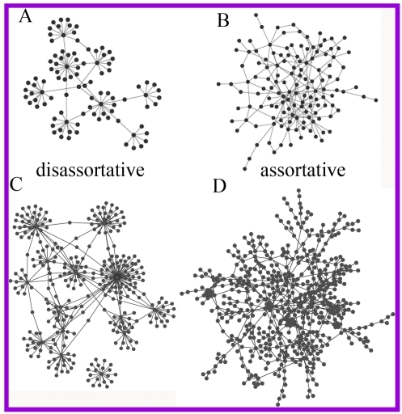
6) Assortativity vs disassortativity:
Assortativity
Disassortativity
Nodes tend to be connected with other nodes with similar degree. On an average
high degree nodes are, connected to other nodes with high degree
low degree nodes are, connected to other nodes with low degree.
In a network on average, high degree nodes are more connected with low degree nodes or vice versa.
https://www.nas.ewi.tudelft.nl/people/Piet/papers/JCN2015AssortativitySurveyRogier.pdf
https://openi.nlm.nih.gov/imgs/512/299/3229552/PMC3229552_pone.0028322.g001.png
Notes:
Assortativity is a graph metric. It represents to what extent nodes in a network associate with other nodes in the network, being of similar sort or being of opposing sort. Assortativity of a network is determined for the degree (number of direct neighbours) of the nodes in the network. A network is said to be assortative when high degree nodes are, on average, connected to other nodes with high degree and low degree nodes are, on average, connected to other nodes with low degree. Example for assortivity is social networks. Example for disassortivity is chemical space networks or biological networks.
How Correlations between nodes of similar degree reflect to have higher correlation . Bt connected nodes will have low correlation in case if have different degree.

Slide 12
Summary:
Chemical space networks .
Network properties :
Node Degree.
Clustering Coefficient.
Path Length.
Community Structure.
Network Density.
Assortativity vs disassortativity.

Slide 13

References:
Notes:
https://www.nas.ewi.tudelft.nl/people/Piet/papers/JCN2015AssortativitySurveyRogier.pdf

Slide 14
Thanks for your attention

